Slide 1
Tulecom Solutions
Group Overview

Slide 2
About us
Tulecom Group is a technology services and management consulting company.
Mission: Collaborate with enterprises to facilitate them reach their objectives, optimizing technological and human factors.
Values:
  Commitment to go in the right direction
  Truthful Communication
  Efficiency and Competitiveness in corporate management
  Transparency in Financing
  Honesty and Fairness in dealing with customers
  Respect and Motivation in personnel management
  Responsibility and commitment to the social environment

Slide 3
Consulting
Strategic and Technologic Consulting
  Knowledge. Good practices that allow organizations’ profitable assets in the present and to plan future demands, capitalizing internal knowledge.
  Technology. Enterprise management systems and tools to support organizations’ knowledge, communications, and specific developments.
  Information. Transform data into useful knowledge, providing mechanisms to assimilate and absorb information to solve problems.
Analyze organizations to identify enhancement opportunities, provide recommendations and develop implementation plans.

Slide 4
Research & Development Main Guidelines
Network Services:
  Advisory, design, development, expert knowledge, marketing
  Internet, Intranet and Extranet Solutions
  Web and Grid Services
  Ad-hoc Networking
Ambient Intelligence:
  e-Health solutions and developments
  Intelligent Environments
  Digital Home
  Home Automation
  Remote-Assistance
RFID Applications:
Context Awareness, Tagging Context and Data Management Solutions

Slide 5
Research & Development Scenarios (I)
Health Care:
  Use technology advances in order to improve quality of live
  Improve efficiency in hospitals and residences
  Automatic localization and management of medicines and medical equipement
Elderly and Assisted Living:
  Improve efficiency in nursing home
  Improve quality of live to elder and disabled people
  Home automation and customized ambients and situations
Generic Architectures:
Middleware research and development
Technologies integration through software applications

Slide 6
Research & Development Scenarios (II)
Education:
  Include educational scenarios in Ambient Intelligence paradigm
  e-Learning applications based in context and personal knowledge
  Information Management and Data Analysis
Conference Scenarios:
  Provide intelligence, Ambient Intelligence, in a conference scenario
  Provide ubiquitous and transparent services to users
  Develop value added services
Information Systems:
Data collection and data provider systems
Customized information delivering on demand and spontaneously

Slide 7
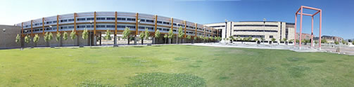


Research & Development Units
R&D Laboratory
R&D Laboratory immersed
in the University of Salamanca
Scientist and Technology Park
BISITE Group:
  Closely colaboration with BISITE Research Group (University of Salamanca)
  Ambient Intelligent, Multiagent and RFID research

Slide 8

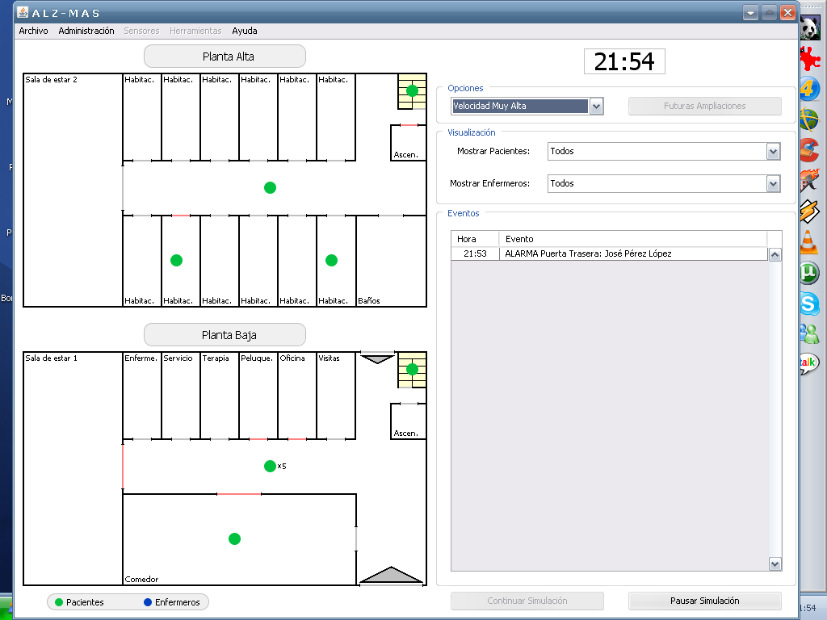
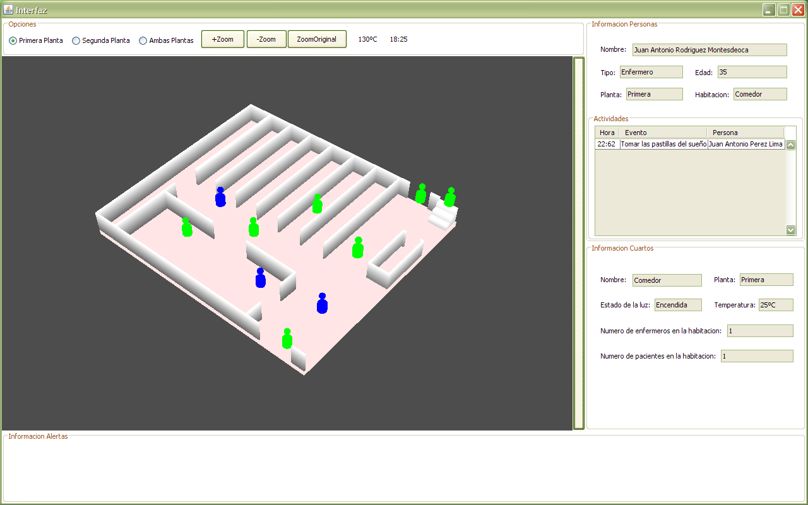
RFID Area (I)
Logistics:
Supply chain, Products management, Transportation, Real-time stock, etc.
UHF Passive Technology -> EPC Class1, Gen2.
Payment Systems:
LF & HF Technology. NFC
Contactless technology
Security Improvement
Parking applications
RTLS:
UHF and Microwave Active Technology
BISITE (University of Salamanca) Tracking System

Slide 9





RFID Area (II)
Access Control
Tulecom provides a hands-free access control solution with many advantages over traditional access control badges and systems
Information Services:
Data management to create Intelligent Places based in Tagging Context
Technology Integration:
Wireless Communications
  NFC, Wi-Fi, Bluetooth, ZigBee, WiMax, etc.
  Tulecom tries to combine technologies, in order to complement each other

Slide 10


Current RFID Projects
AFA
Access Control and Data Management
Improves shift work
ALIADO
Efficiency and Security Improvement
in alzheimer’s patients care
LOCALIZA
RTLS using active RFID
Research in new methods to improve the error rate obtained
AFA Salamanca

Slide 11


































Strategic Alliances
AFA Salamanca

Slide 12
Headquarters: Salamanca, Spain.
Offices:
Phone:
Mail:
Web: www.tulecom.com

